Slide 1
Modern behavioral approach to obsessive-compulsive and related disorders
Michael Twohig, Ph.D. & Julie Petersen
Utah State University
ACBS 2020

Slide 2
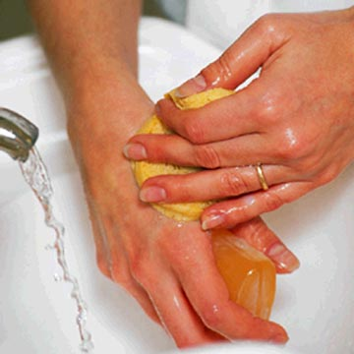
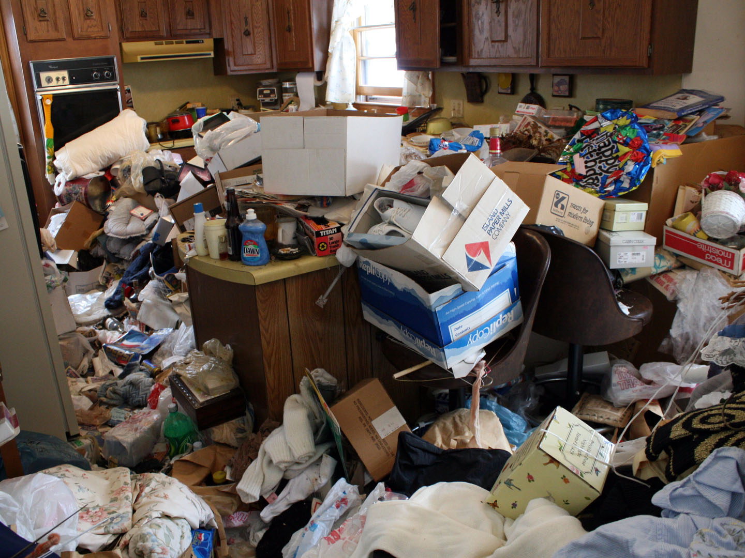
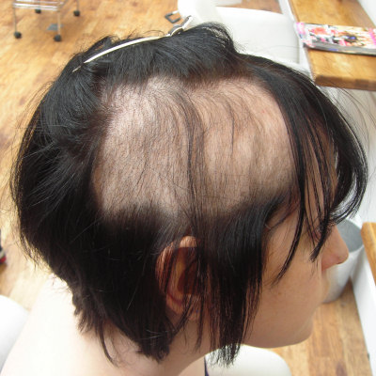
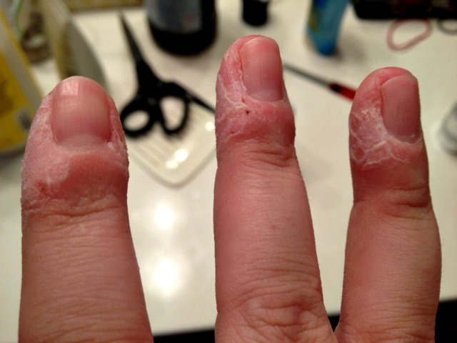
Obsessive-compulsive and related disorders
(OCRDs)

Slide 3
Psychological inflexibility in OCRDs
Experiential avoidance
Cognitive fusion
Low mindful awareness
Differential attention to experiences
Bluett et al., 2015
Notes:
Examples for each disorder

Slide 4
Notes:
Ocd
-cognitive fusion w/obsessions
Trich/skin picking
-inhibitory deficits/emotion dysregulation
-automatic pulling (out of awareness)
Hoarding
-avoidance of shame while discarding for example
Bdd
-low mindful awareness, body checking or disconnection from values

Slide 5
ACT for OCRDs
Treatment outcomes

Slide 6
ACT for OCD RCTs
Y-BOCS scores

Slide 7
ACT for OCD RCTs--Adults
Y-BOCS scores

Slide 8
ACT for OCD RCT—Adolescent Twohig et al in prep
Y-BOCS scores

Slide 9
ACT for BDD open trial Linde et al (2015)
Y-BOCS scores

Slide 10
ACT for BDD
An area in need of further investigation
One multiple baseline found improvements in worry, interpersonal problems, and quality of life in clients with BDD (Dehbaneh, 2019)
Promising results from small trial of ACT+exposure therapy for BDD (Linde et al., 2015)
Notes:
Linde study: At post-treatment, symptoms of BDD, depression, psychological flexibility, quality of life and general functioning were significantly improved

Slide 11
ACT for Hoarding disorder
Prevalence of hoarding is shockingly high
AAQ-Hoarding (Krafft et al., 2019)
Ong and Krafft multiple process of change studies (Ong et al., 2019; 2019; Krafft et al. 2019)
Multiple baseline (Ong et al., under review)
Notes:
Linde study: At post-treatment, symptoms of BDD, depression, psychological flexibility, quality of life and general functioning were significantly improved

Slide 12
ACT for OCRDs
Implementing treatment

Slide 13
ACT for OCD
ACT with limited exposure or ACT with lots of exposure
Limited exposure
Creative Hopelessness
Control as a Problem
Acceptance
Defusion
Self as context/ being present
Behavioral commitments at session 3ish
Values last two sessions

Slide 14
ACT’s view on Exposure
3 or so sessions setting up exposures
Procedure
Contacting feared stimuli
And/or engaging in valued activities
While practicing ACT concepts
Process of change
Psychological flexibility
Desired outcome
Greater life functioning
Change in internal experience not a concern

Slide 15
Habit Reversal
Awareness training
Competing response training
Social support
Combining with ACT

Slide 16
ACT for hoarding disorder
Creative Hopelessness/control as a problem
Values (connecting to discarding)
Acceptance
Defusion
Self as context/ being present
Behavioral commitments

Slide 17
Thanks!
Any questions?

